Slide 1

Performance-based Tolerance Specification for a
Centrifugal Pump Impeller
Michel Noaparast, Development Engineer
Tobias Randers Olesen, Senior Development Engineer
Dr. Nicholas Pedersen, Senior Manager
GRUNDFOS PRODUCTS AND OFFERINGS
Notes:
We are from hyd. development, etc. Etc, working with bla bla – putting it in context

Slide 2

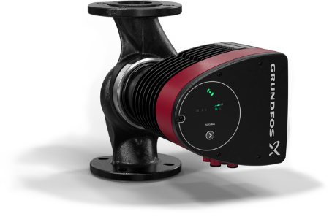
#1
74
83
Pump manufacturer in the world
Years old (founded in 1945)
Companies across the world
16
19
Million units produced every year
Thousand employees worldwide
Companies
3.6
1
Turnover (billion Euros) 2018
Owner

Slide 3
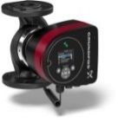
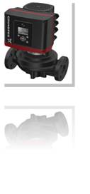
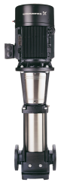
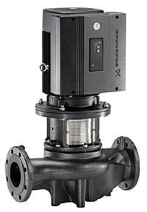
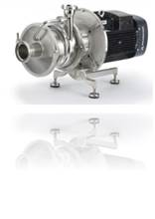
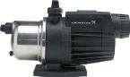
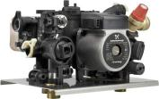

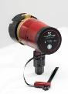
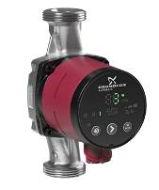
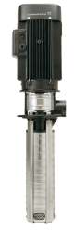
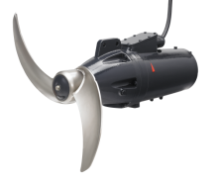
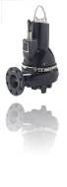
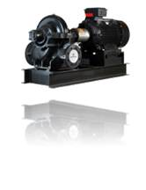
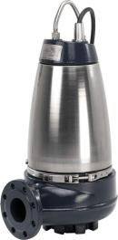
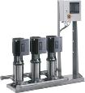

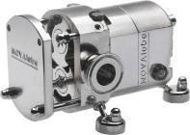
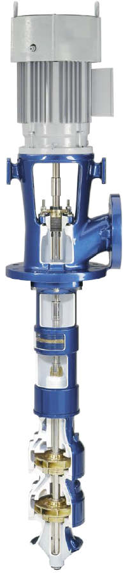
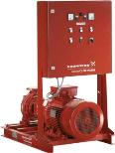
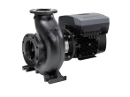
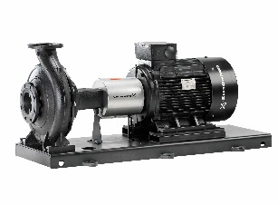
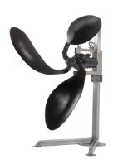
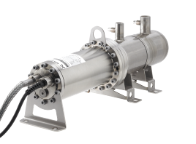
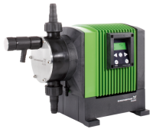
GRUNDFOS PRODUCT RANGE

Slide 4
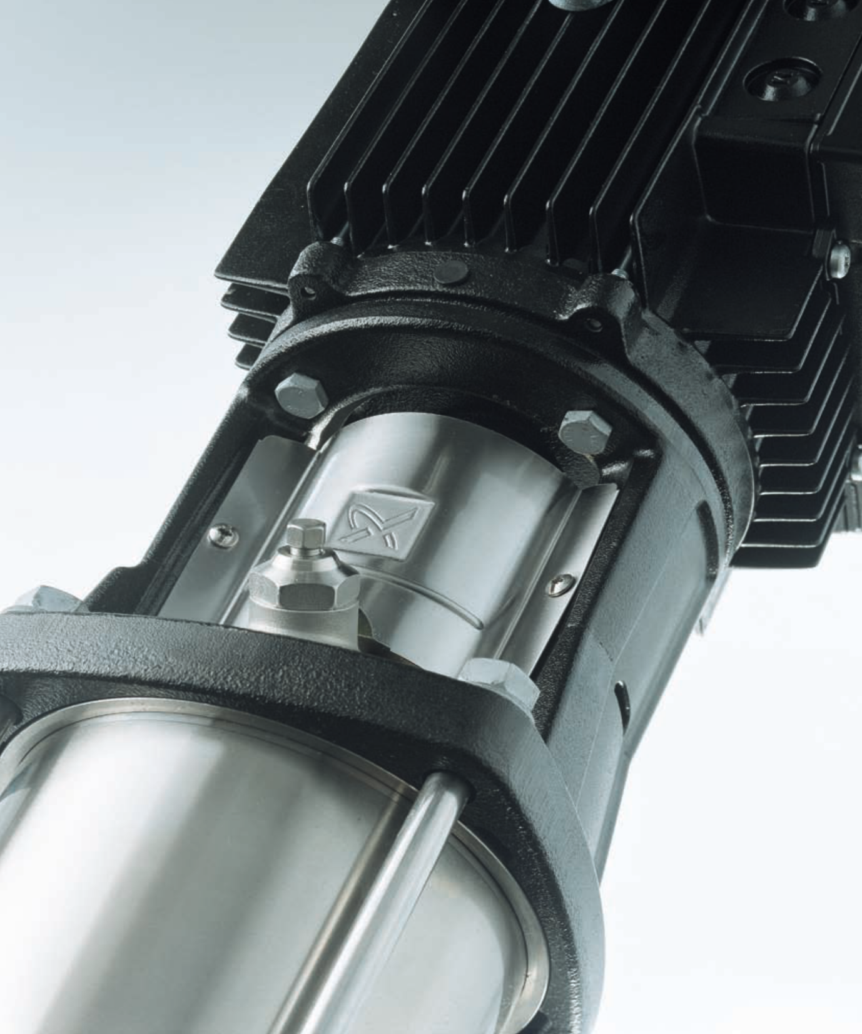
Contents
Motivation
Simulation set-up
Parametrization
Perturbation method
OptiSLang set-up
Results
Conclusion

Slide 5
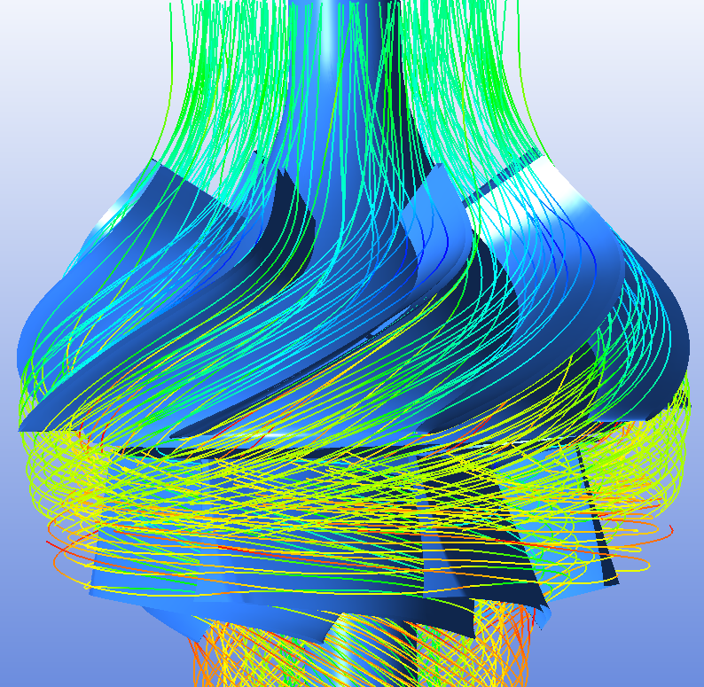
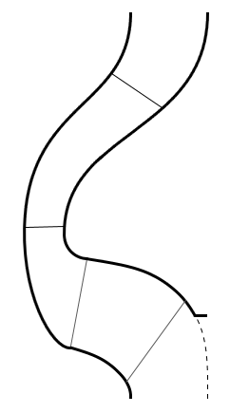
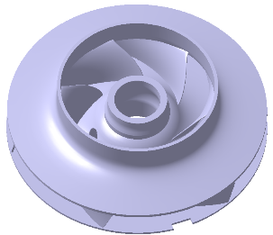
1. Motivation Development process
Hydraulic designer
Tolerance specialist
?

Slide 6
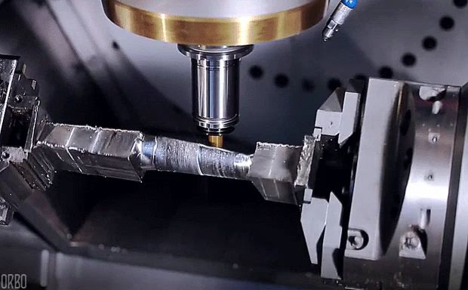
Tooling specialist

Slide 7
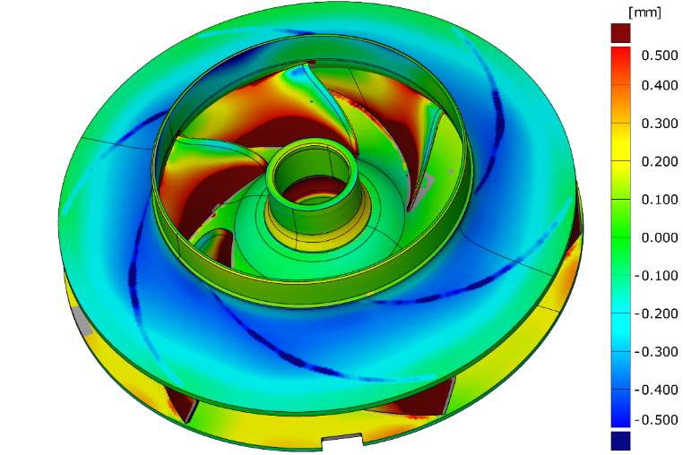
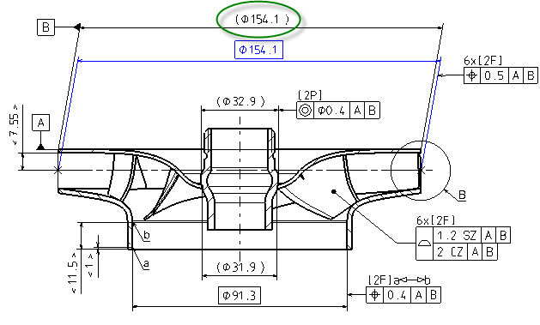
1. Motivation Development process
Hydraulic designer
Tolerance specialist
Produced component
with deviations

Slide 8


Motor limit

Slide 9
Variations are unavoidable
so how do we control them?
so how do we predict their impact?
so how can we reduce their impact?
Hypothesis
Can be done by replacing traditional tolerances with tolerance zones based on sensitivity studies.

Slide 10
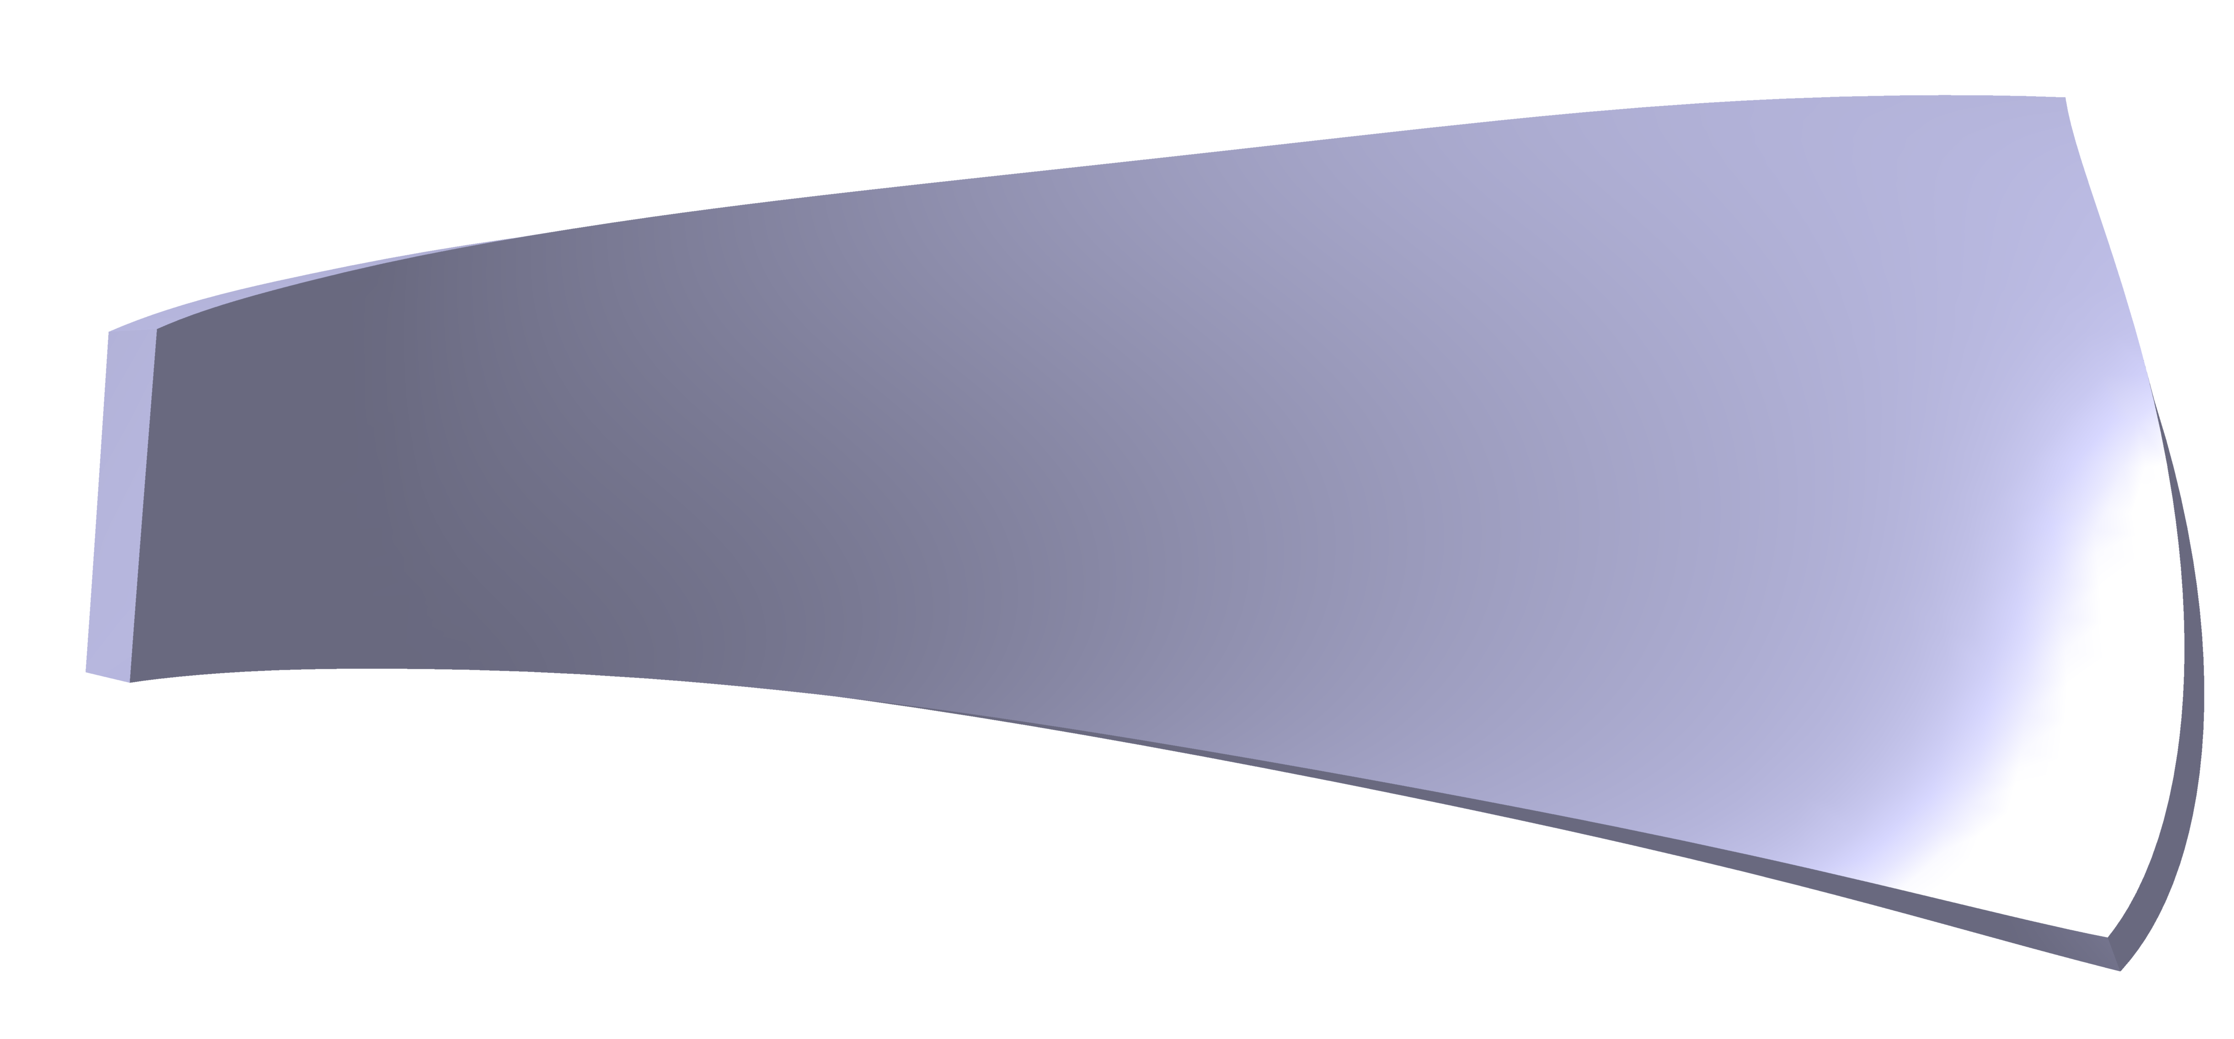
Hypothesis
Can be done by replacing traditional tolerances with tolerance zones based on sensitivity studies.
Same tolerances
Loose
Strict

Slide 11
Solution
Robustness evaluation
Create mesh
Perturb/Deform geometry
Perform CFD
OptiSLang/DoE

Slide 12
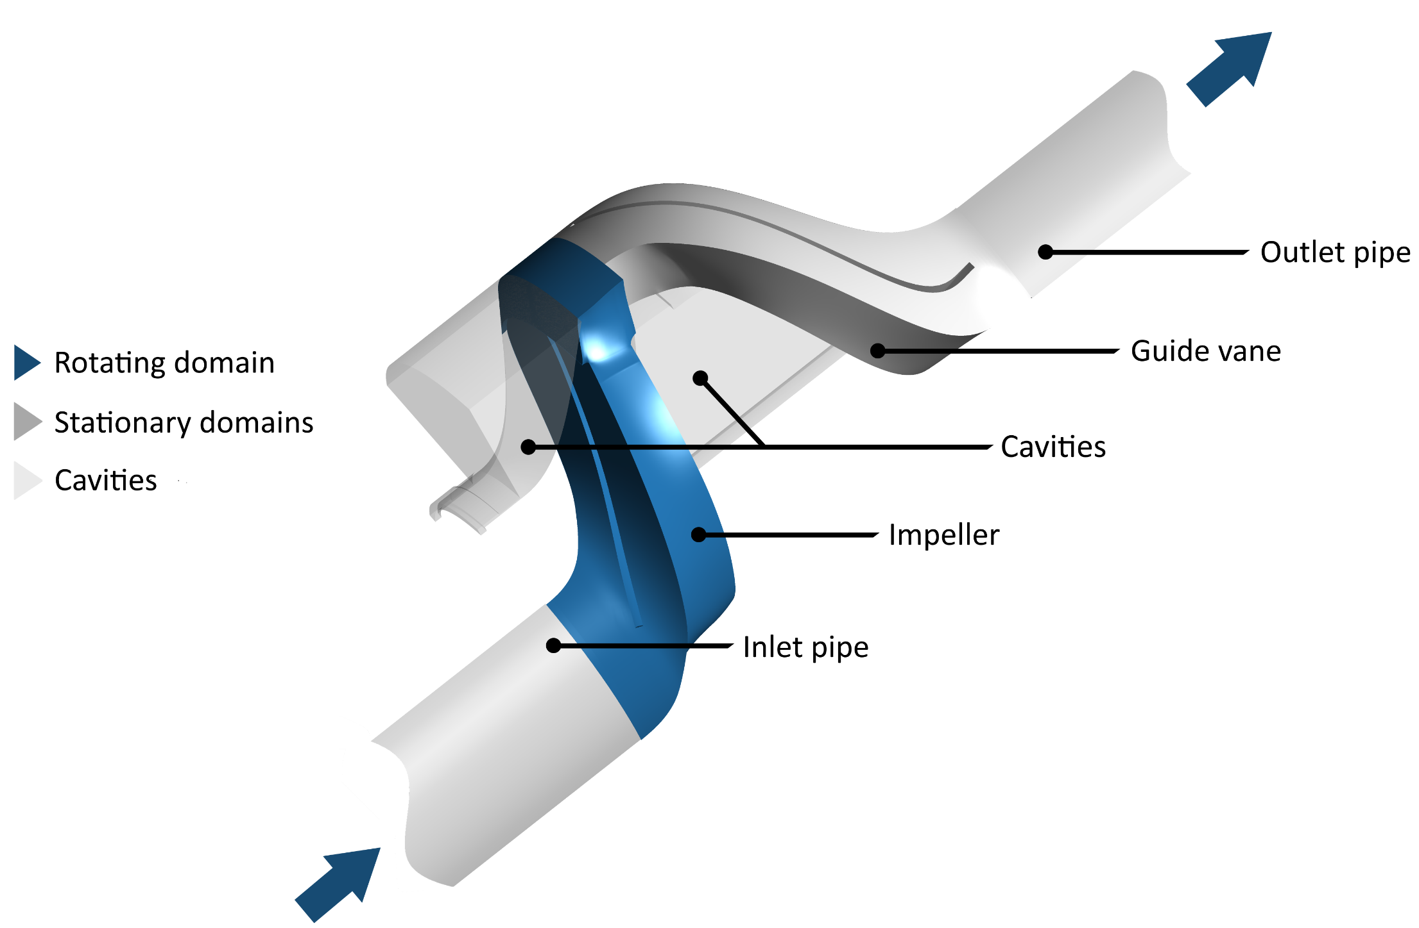
2. Simulation set-up Fluid domain

Slide 13
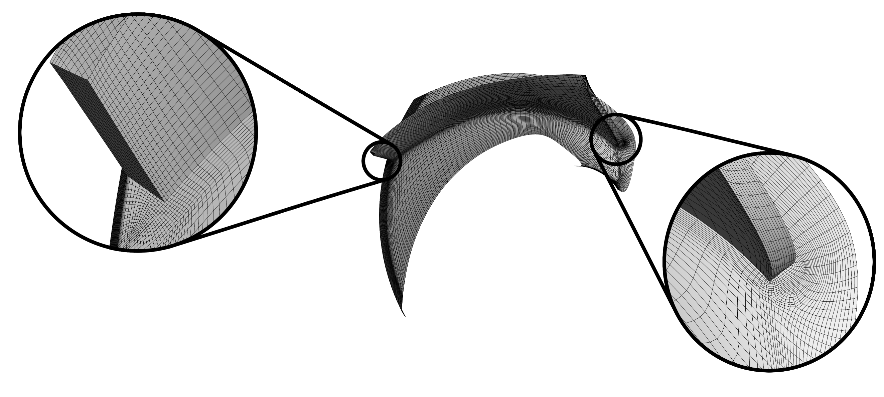
2. Simulation set-up Mesh properties
 | Cell count | Min. orthogonal angle
Full domain | 585,330 | 24.7
Structured hexahedral meshes

Slide 14
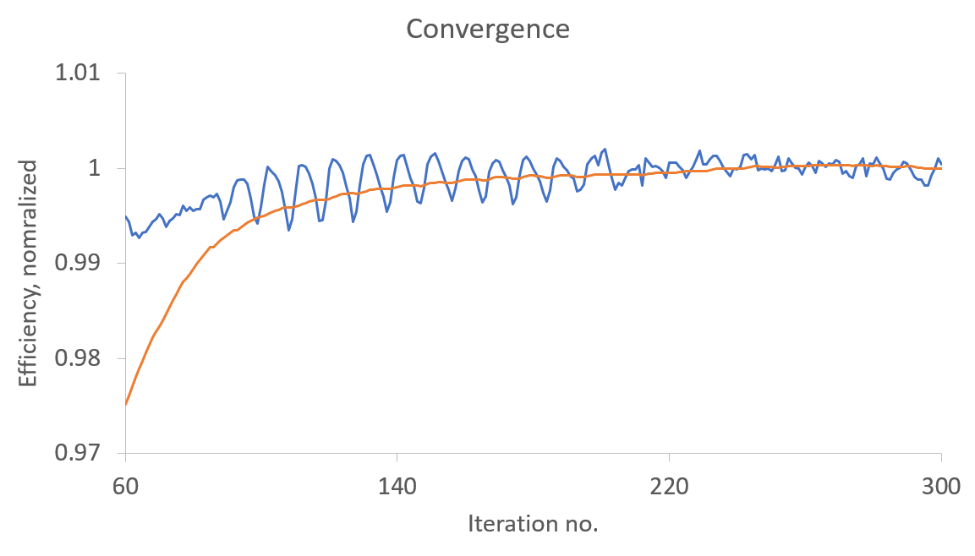
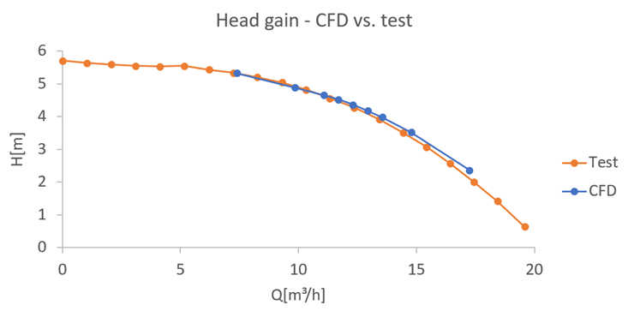
2. Simulation set-up CFD simulation
Convergence good, averaged result
Averaged
Moving average
Iteration value

Slide 15
2. Simulation set-up CFD simulation
Averaged
Convergence good, averaged result
Moving average
Good match between CFD and test
Iteration value

Slide 16
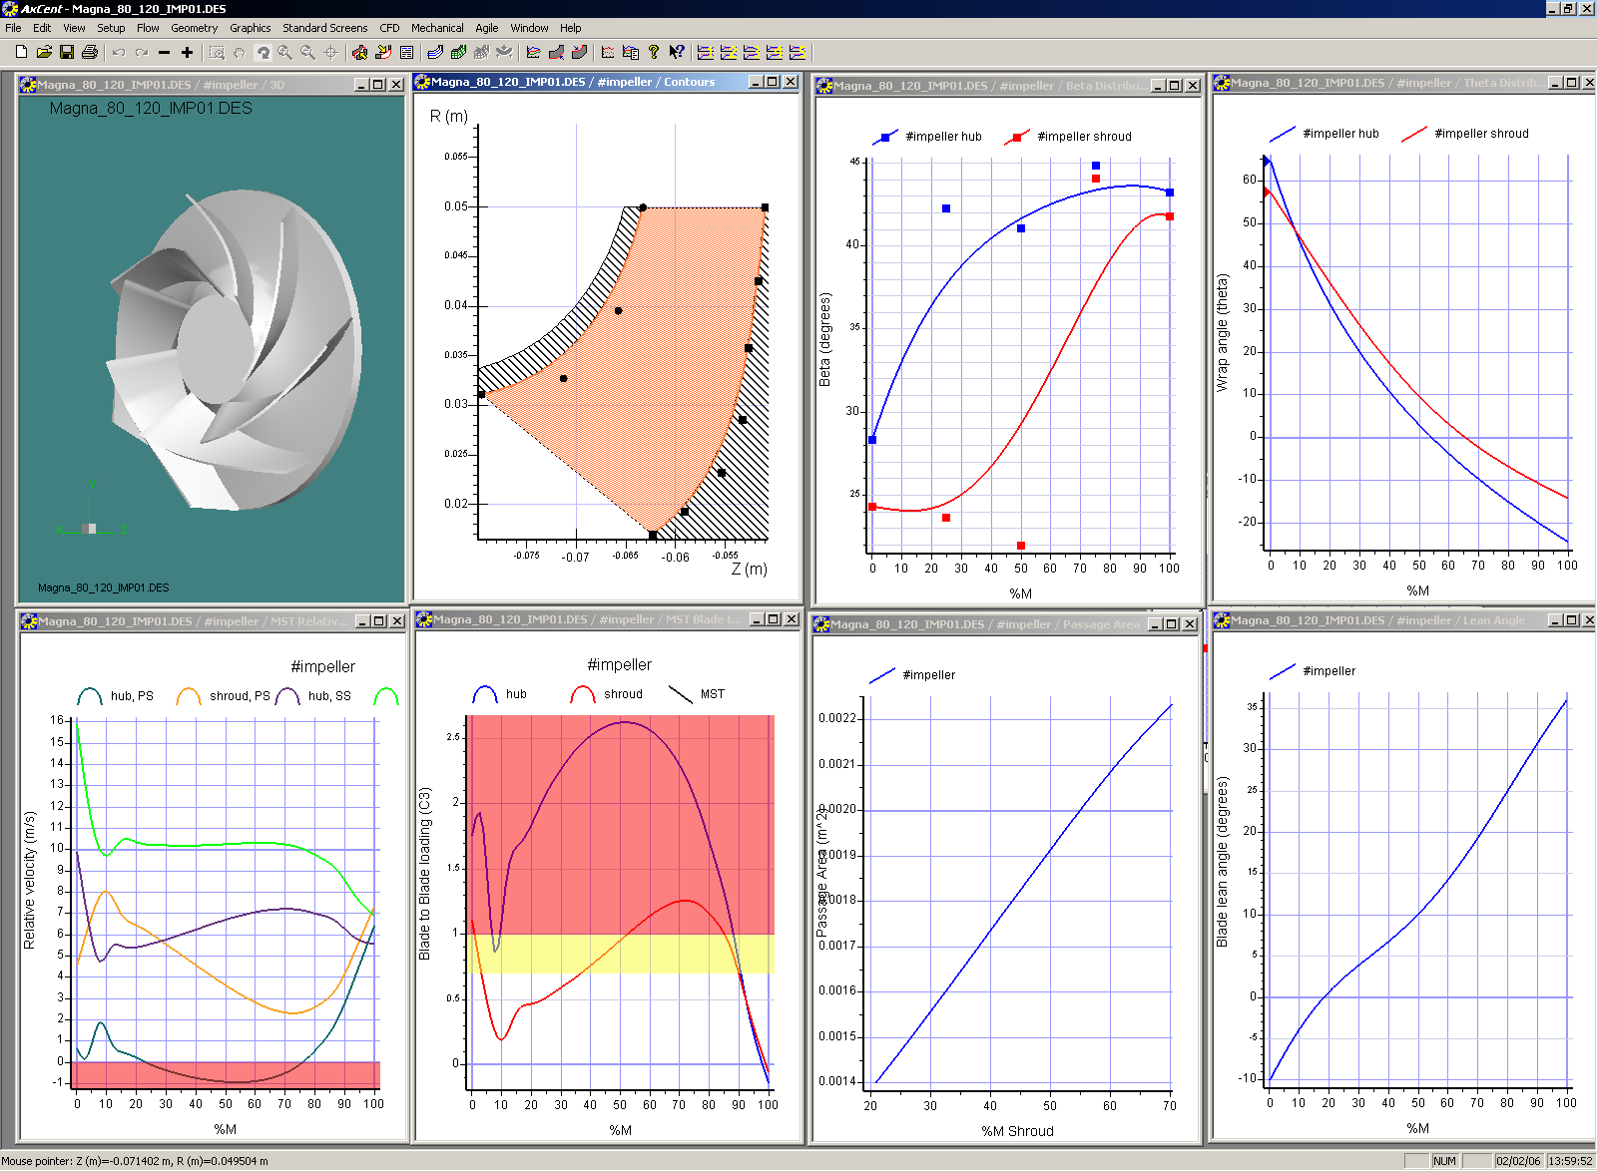
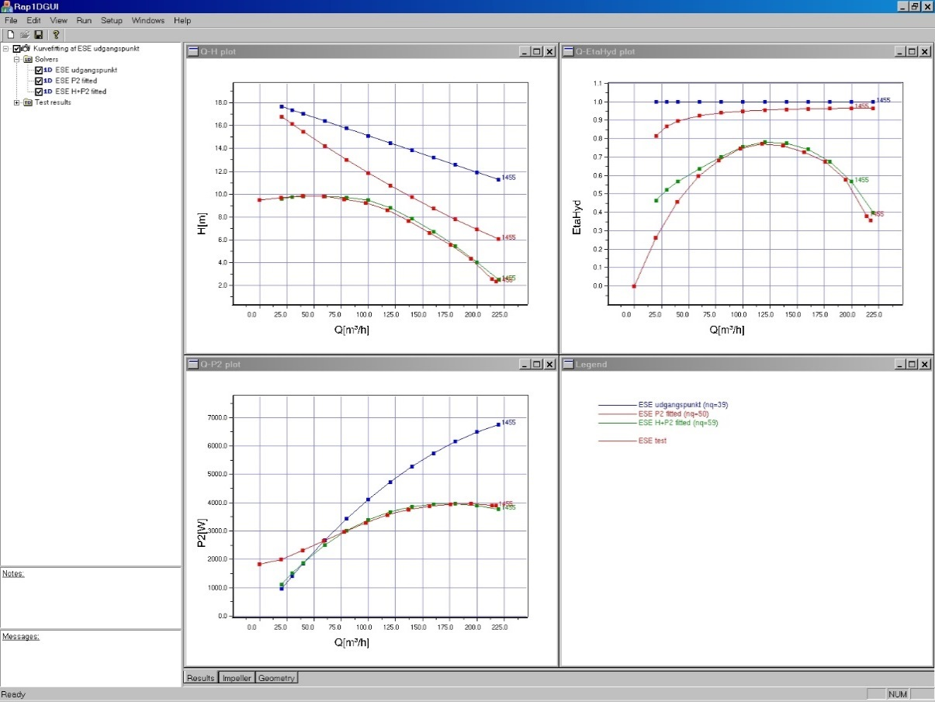
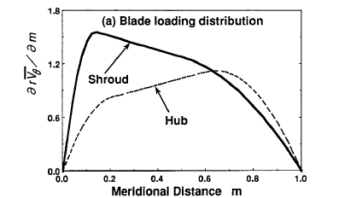
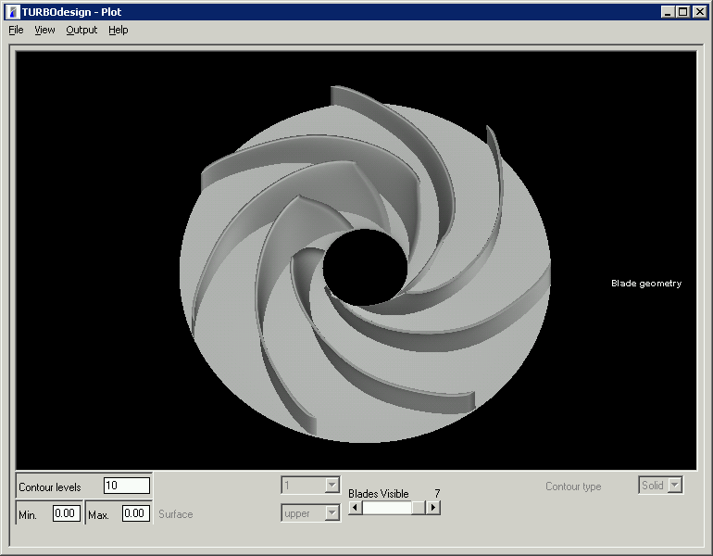
3. Parametrization Hydraulic design methods
Conventional hydraulic design method
Direct specification of blade angle distribution
No direct specification of loading or performance
Not suited for imitating production variations
Inverse hydraulic design method
Specification of performance and blade loading (pressure difference across blade)
No direct specification of blade angles
Notes:
You could make geometric variations, but it would be difficult to impose stochastic variations seen in productions.

Slide 17
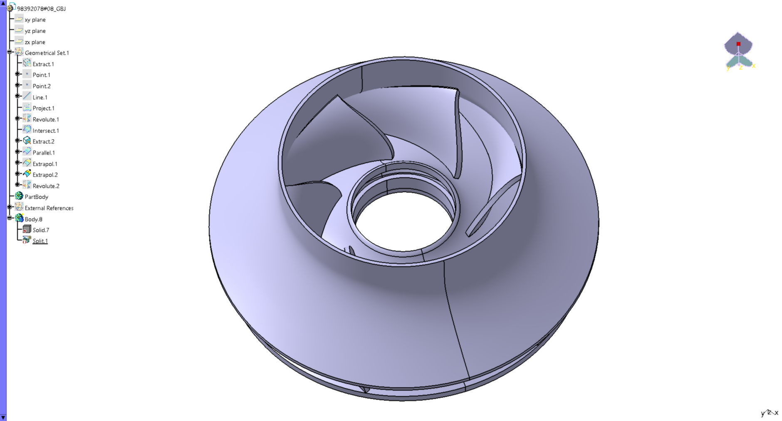
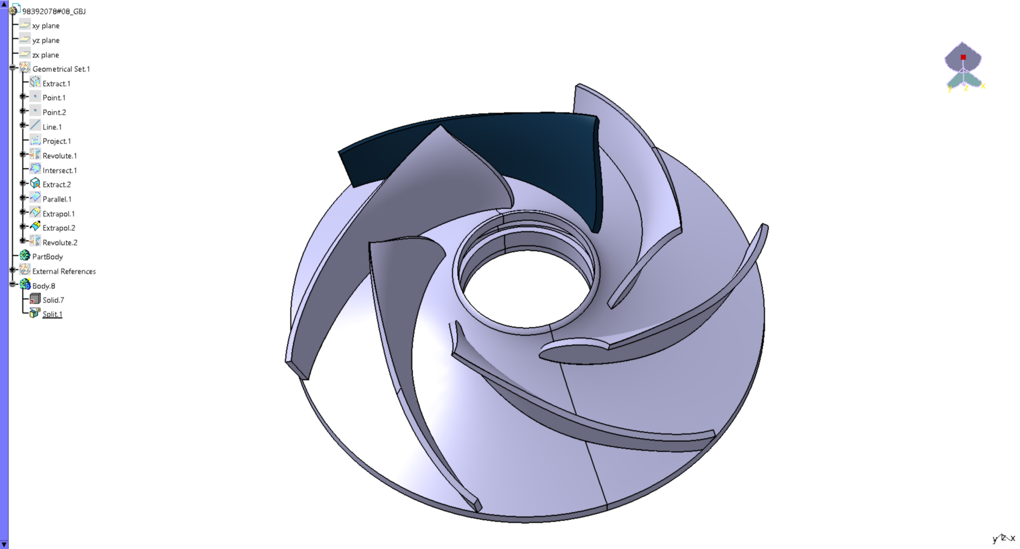
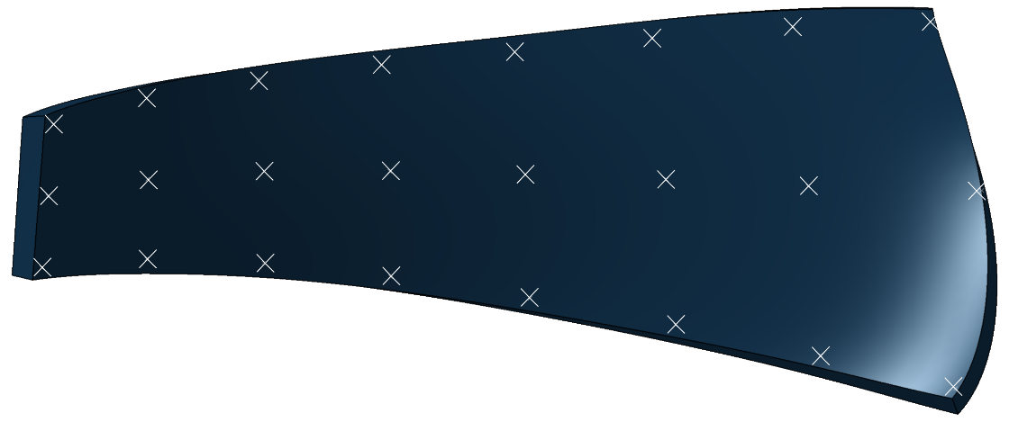
3. Parametrization Geometric parametrization
Advantages:
Parameters linked to geometry changes
Easy to impose tolerances
Easy to mimic specific production variations
Metal sheet impeller
8x3 control points
Displacement normal to the surface
Constant blade thickness

Slide 18
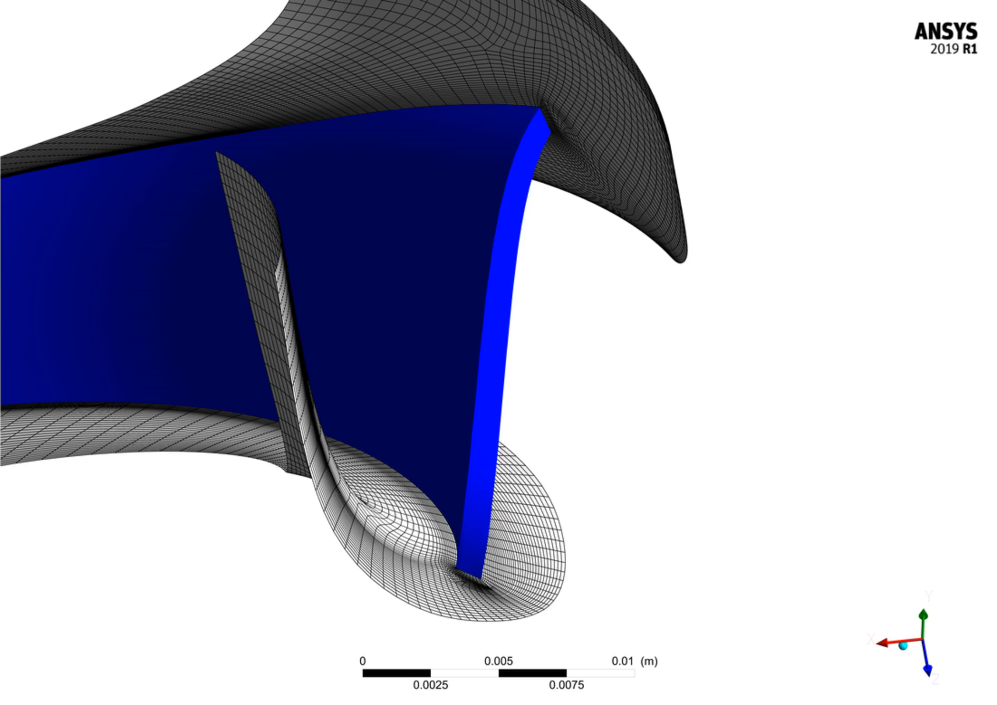
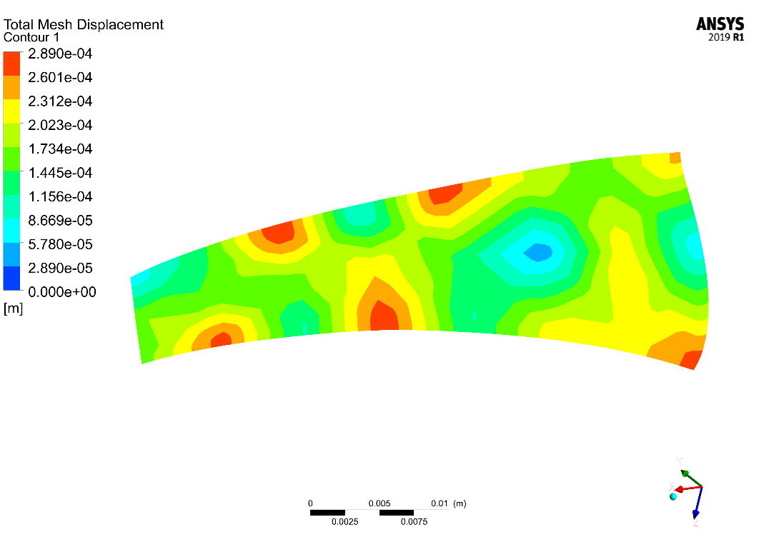
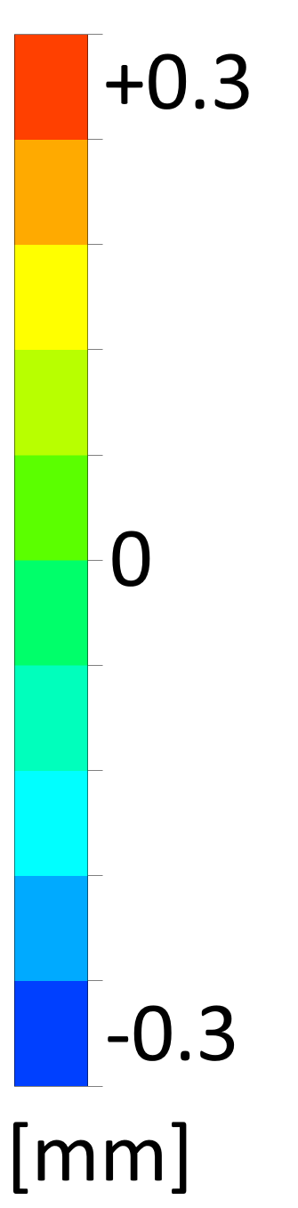
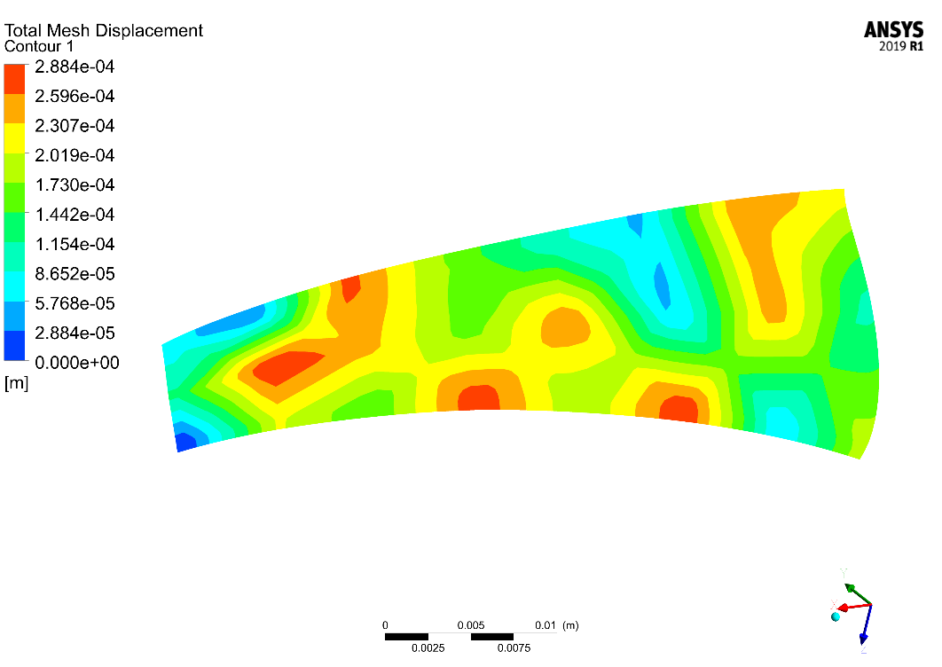
4. Perturbation method Mesh morphing
LE
TE
LE
TE

Slide 19
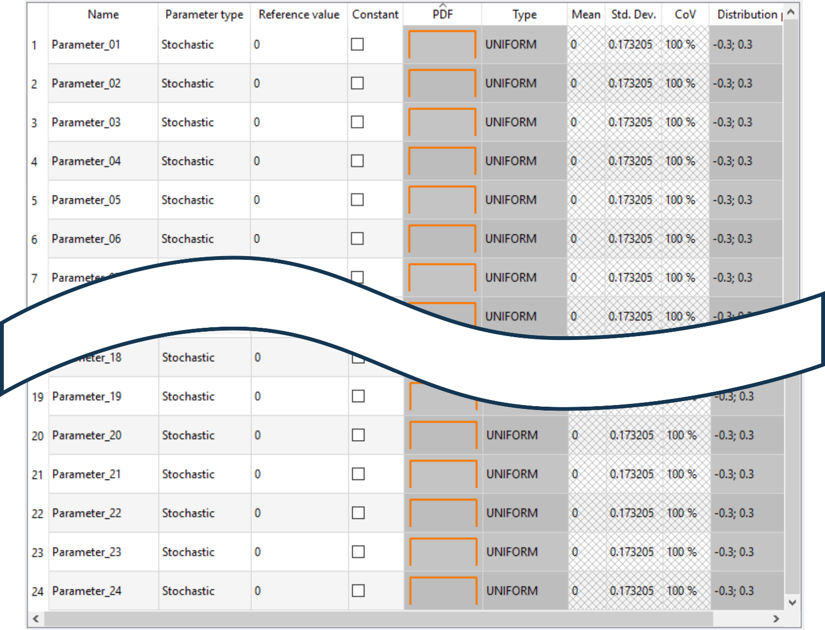
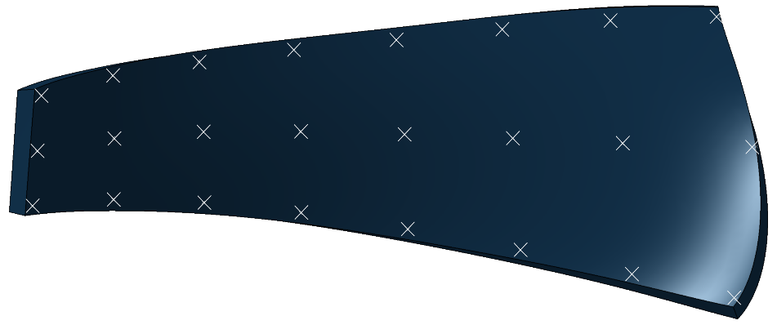
5. OptiSLang set-up Parameters
Robustness evaluation
Advanced Latin Hypercube Sampling
100 samples (>2k)
Responses
Head
Power consumption
Efficiency
Minimum pressure
Axial force

Slide 20
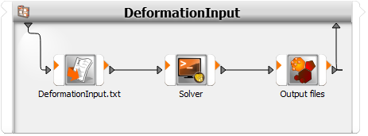

5. OptiSLang Solver call
Text-based solver (bash)
Python
Deform
geometry
Perform CFD
OptiSLang/DoE

Slide 21

6. Results Key statistics
Samples | Initial | 100
 | Failed | 0
 | Removed | 4
 | Remaining | 96
CoP | Head | 96 %
 | Power consumption | 96 %
 | Efficiency | 91 %
 | Minimum pressure | 98 %
 | Axial force | 95 %

Slide 22






6. Results Visualization of the sensitivity
Head
Power consumption
Efficiency
Minimum pressure
Axial force

Slide 23







6. Results Visualization of the sensitivity
Head
Combined sensitivity
Power consumption
Efficiency
Minimum pressure
Loose
Strict
Strict
Axial force

Slide 24



6. Results Adjusted tolerance zones
Case 1
Case 2
Case 3
+/- 0.1 mm
+/- 0.3 mm
+/- 0.5 mm

Slide 25
6. Results Adjusted tolerance zones
Prediction of tolerance impact
Peak difference: 2.5 %-points
Case 1
Case 3
+/- 0.1 mm
+/- 0.3 mm
+/- 0.5 mm

Slide 26
7. Conclusion
Sensitive regions identified
Tighten tolerances in important regions
Loosen tolerances in less important regions
Reduce complexity and/or increase performance
Estimated performance variations
Optimize tolerances and avoid over-engineering
Estimate required safety margins in design phase
New methodology
Applicable to any geometry

Slide 27
7. Conclusion
Sensitive regions identified
Tighten tolerances in important regions
Loosen tolerances in less important regions
Reduce complexity and/or increase performance
Estimated performance variations
Optimize tolerances and avoid over-engineering
Estimate required safety margins in design phase
New methodology
Applicable to any geometry
Next steps
Test on more geometries
Include in design procedures

Slide 28


